Slide 1



E-COMPANY
DATA ANALYSIS

Slide 2

MAIN KPIS
105 M
6 M
1 M
10
Total Sales
Quantity Sold
Transaction
Number Of Suppliers

Slide 3
Main Tables
Customer
Fact Table
Item
Store
Time
Transaction
1

Slide 4
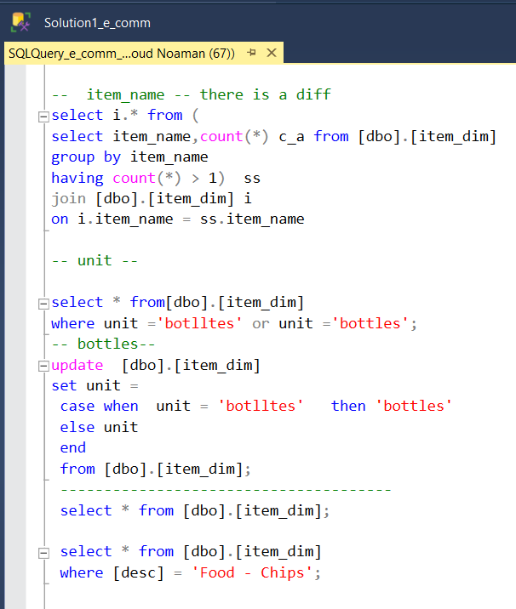
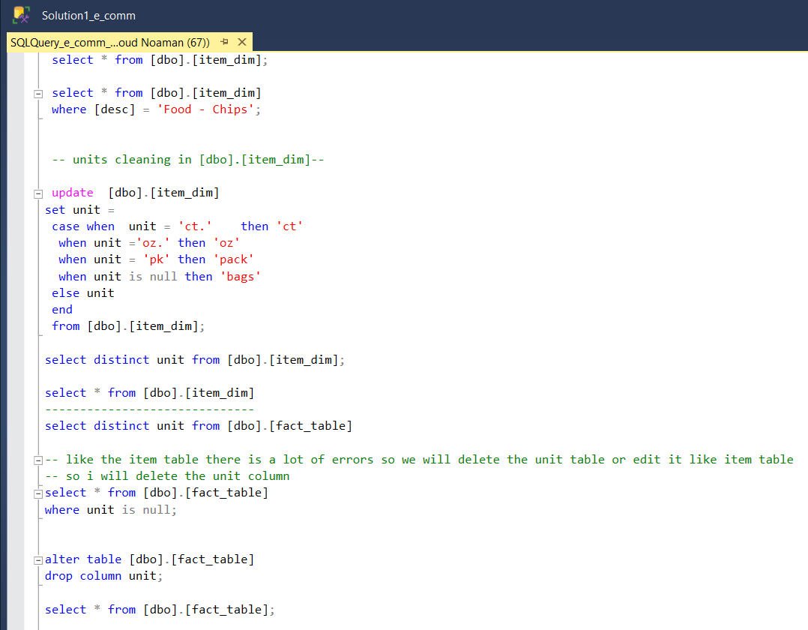
Data Cleaning

Slide 5
1
Project Details

Slide 6
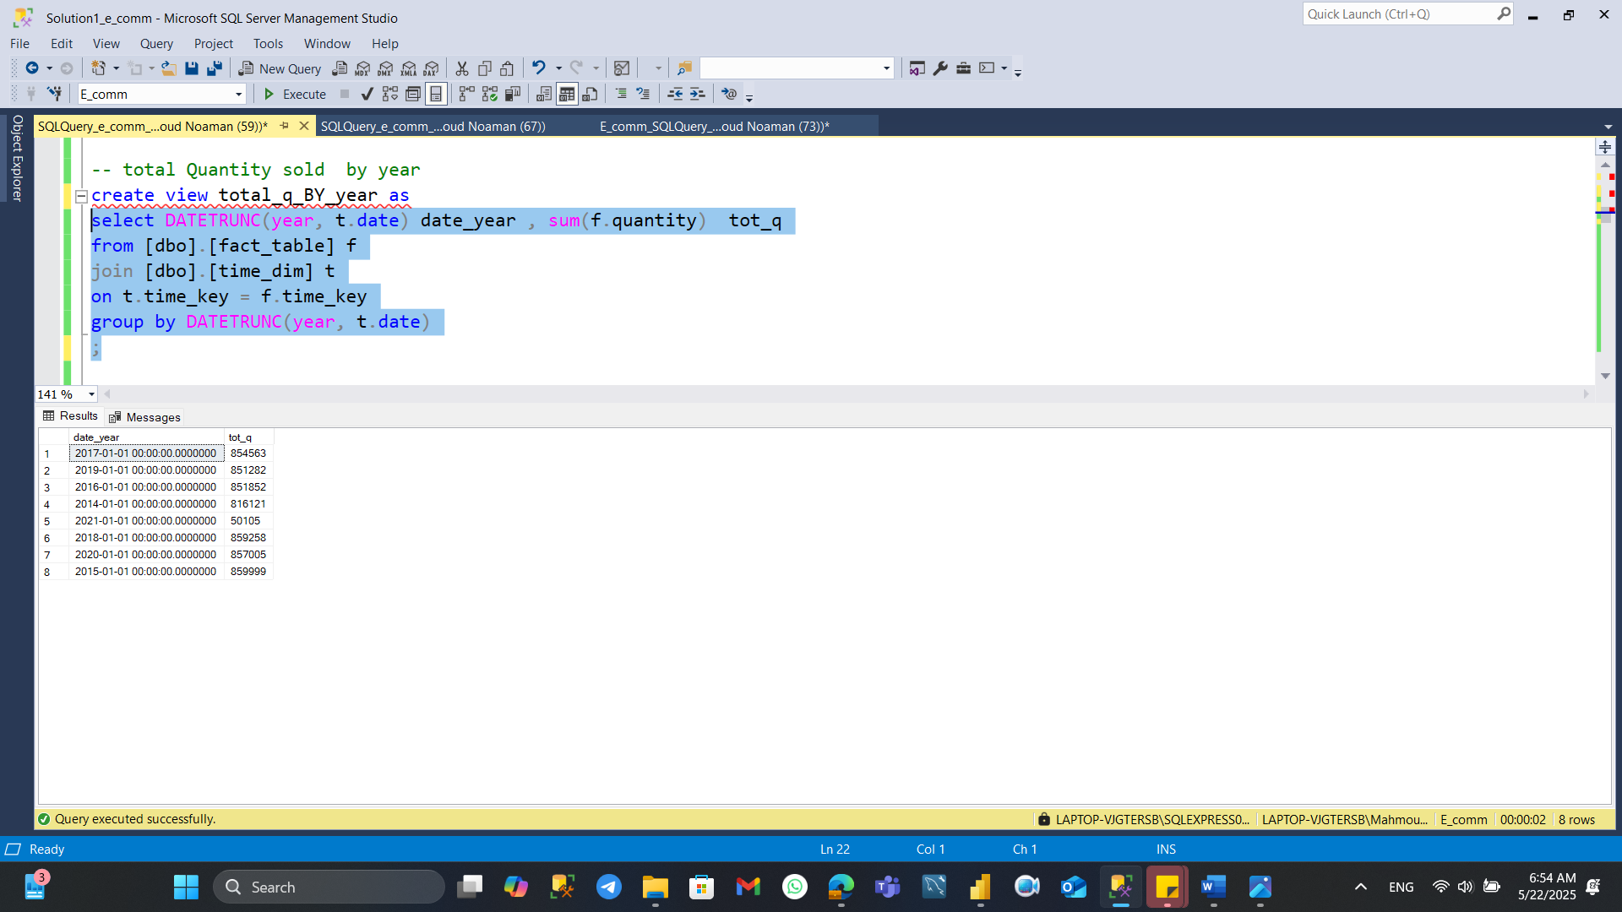
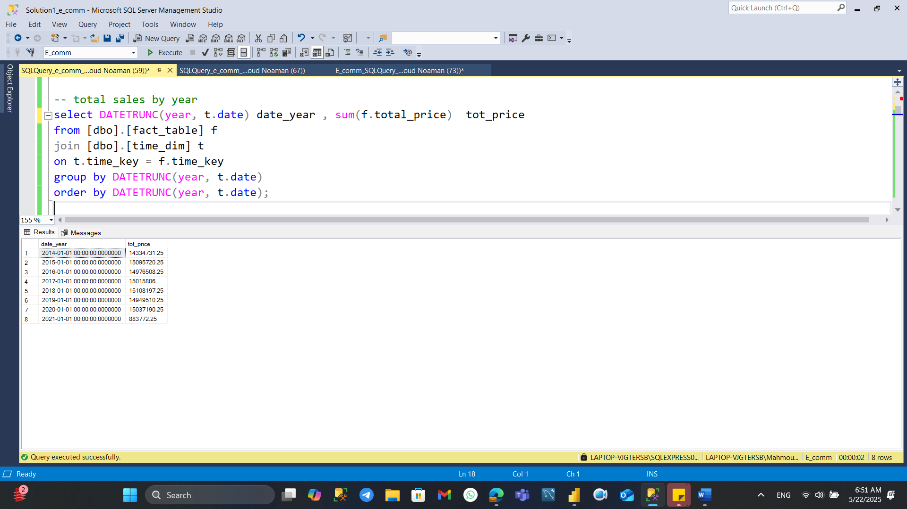
1- What is the Total Quantity and Sales over the years

Slide 7
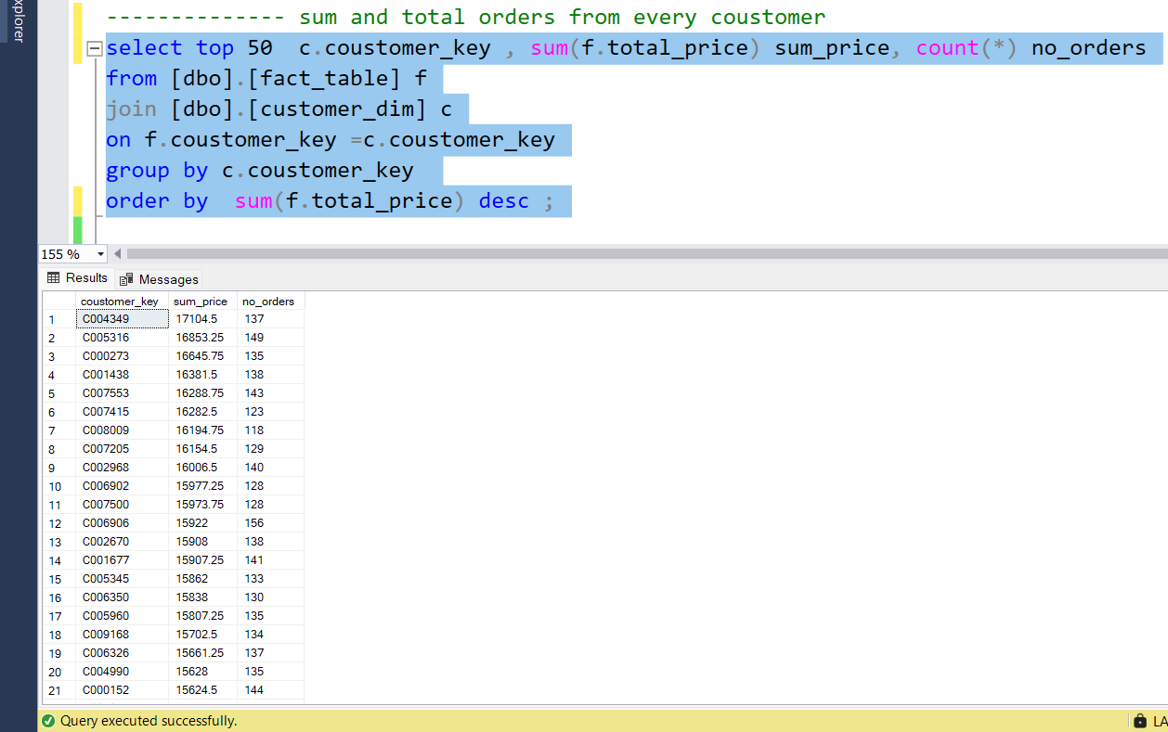
2-Sum &Total Number of orders from every customer

Slide 8
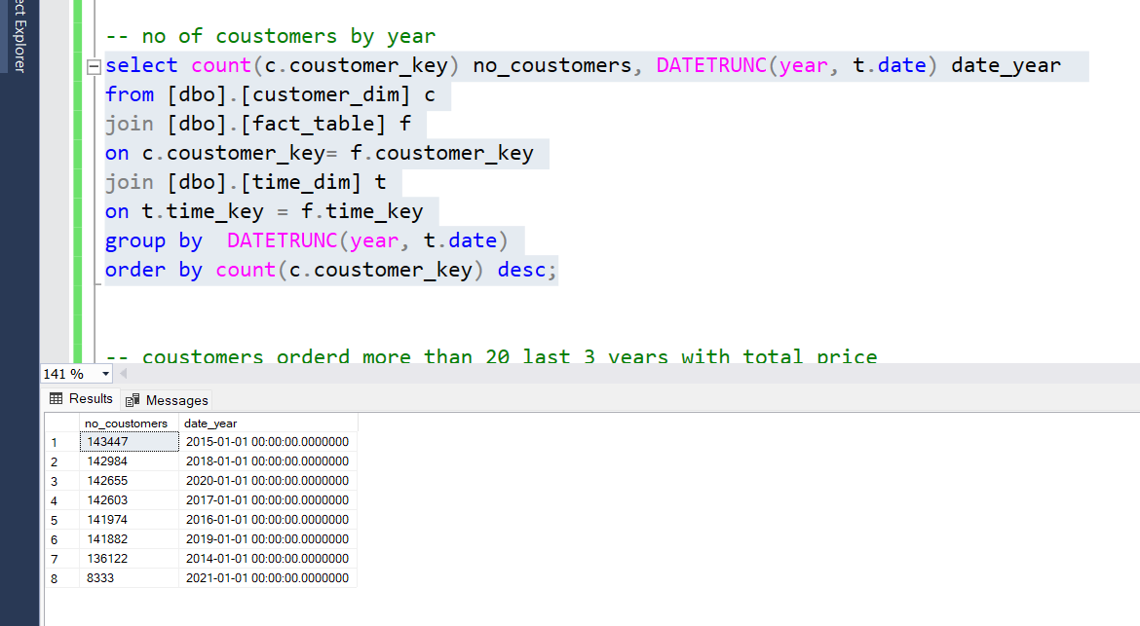
3-Number of customers by year

Slide 9
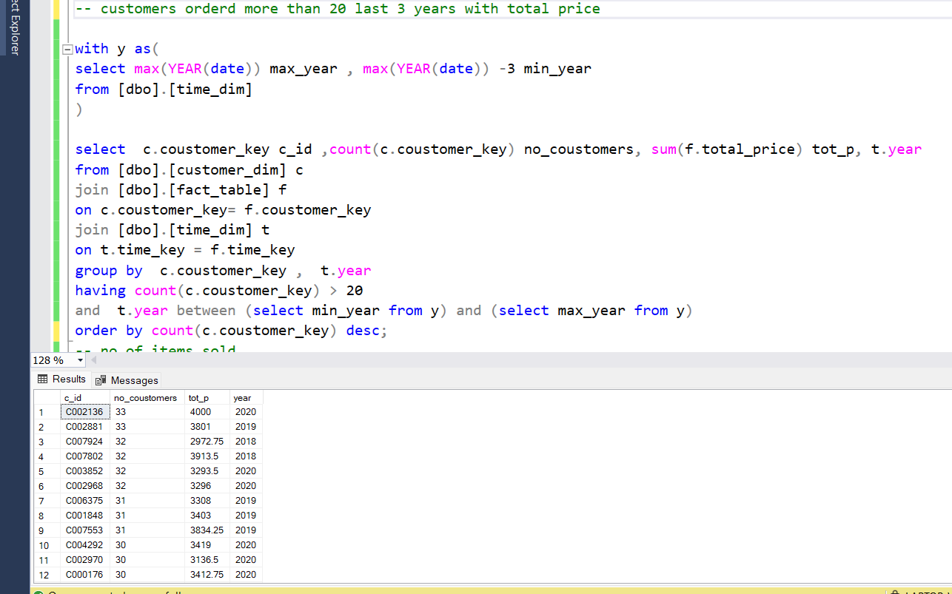
4 -Customers ordered more than 20 order last 3 years and the total price

Slide 10
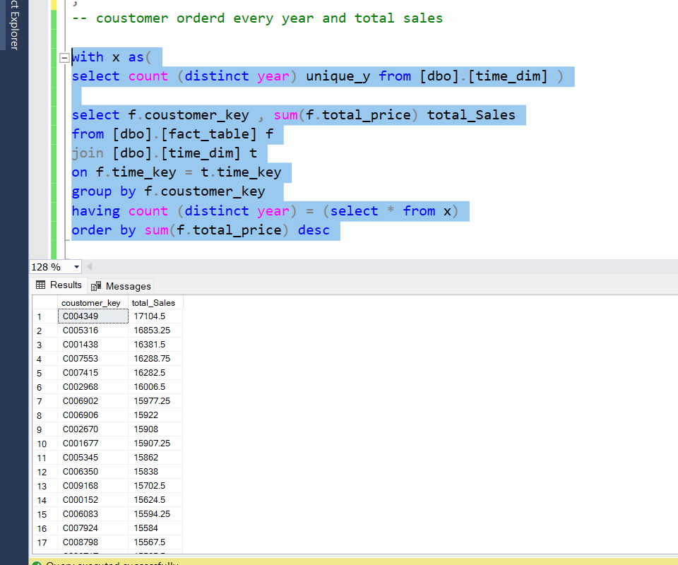
5- Customers ordered every year, and the Total sales (Loyal Customers)

Slide 11
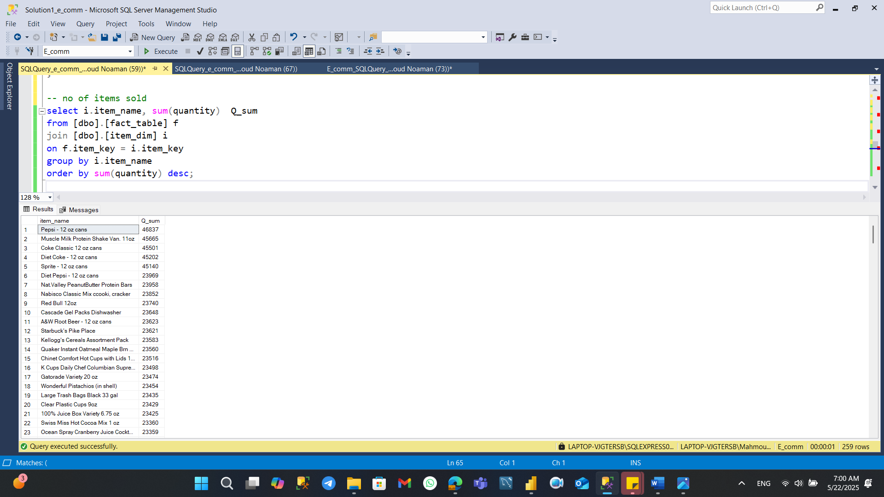
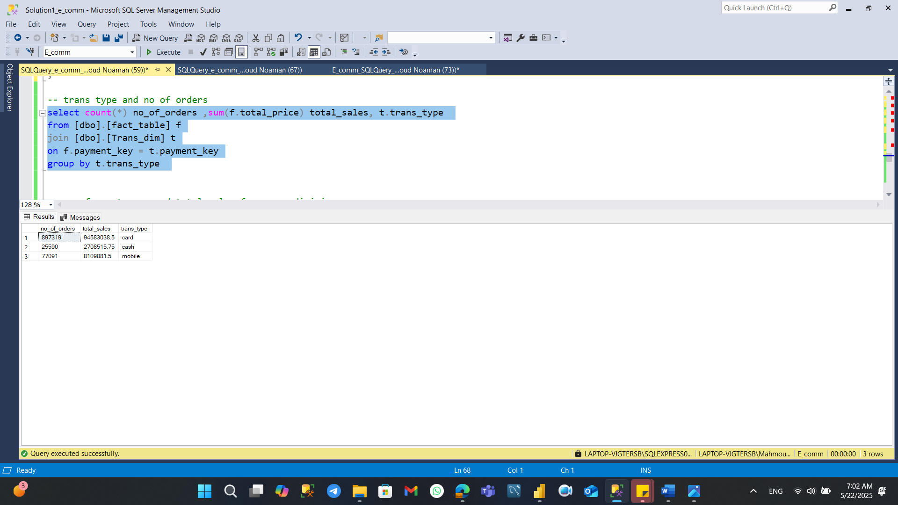
6- Sum of Quantity sold for every Item
7- Transaction type & Number of orders & Total Sales

Slide 12
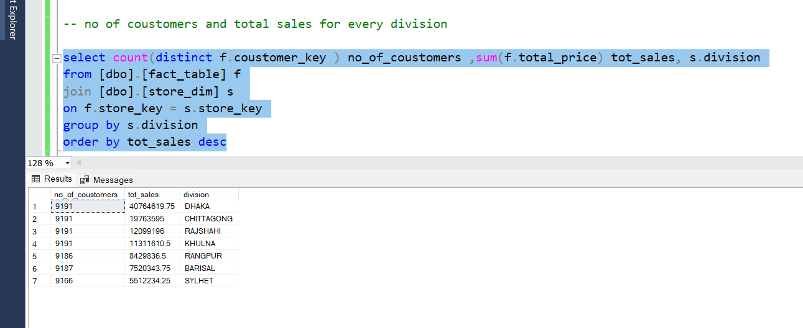
8- Number of customers and total sales for every Region

Slide 13
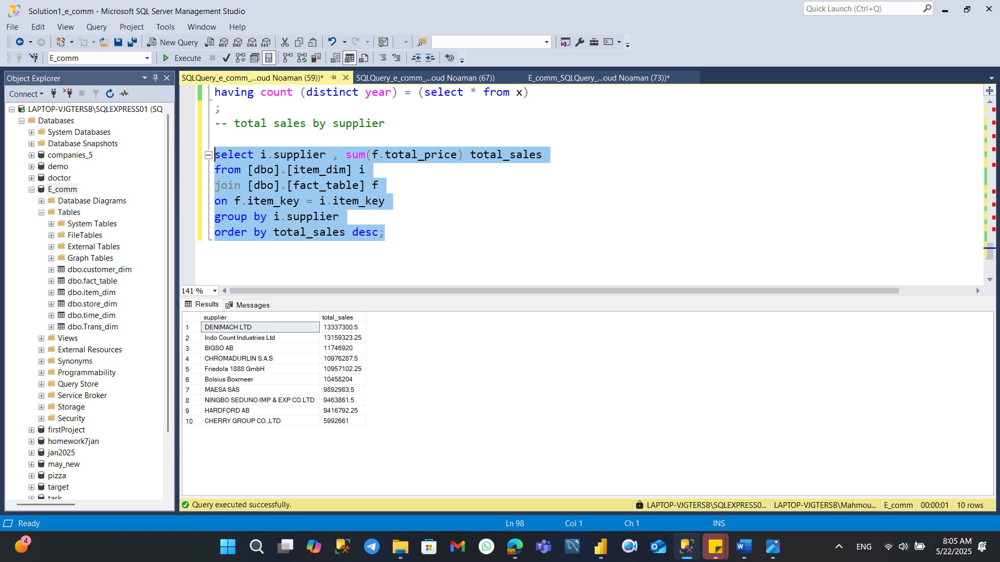
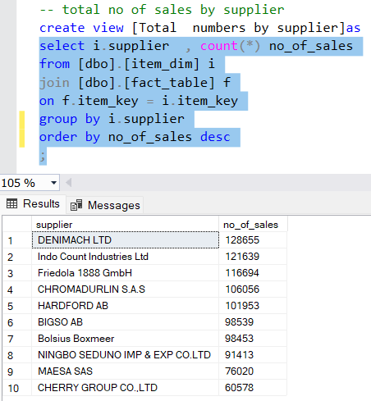
9 - Total sales by supplier
10- Total number of sales by supplier

Slide 14
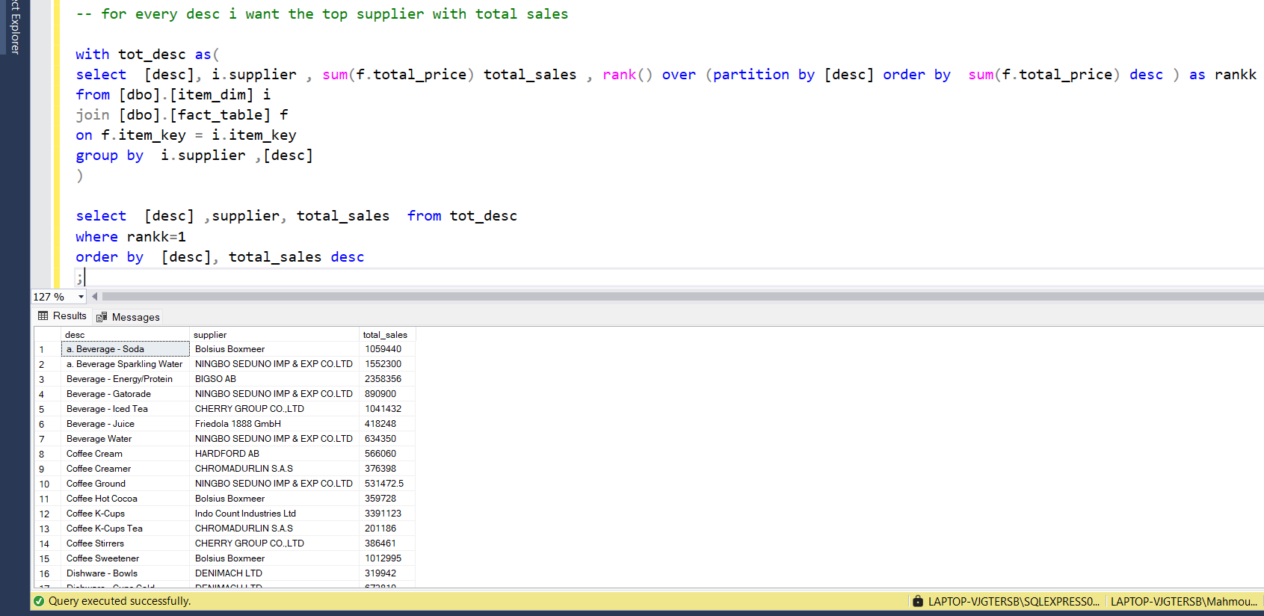
11- Top supplier with total sales sort by item description

Slide 15
1
Dashboard

Slide 16
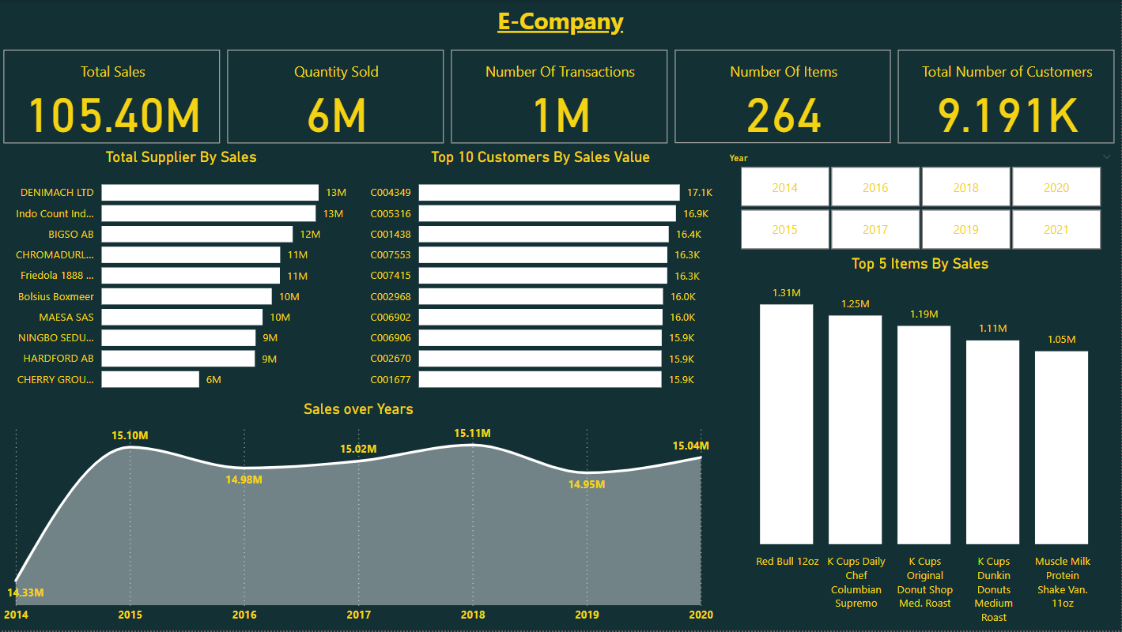

Slide 17
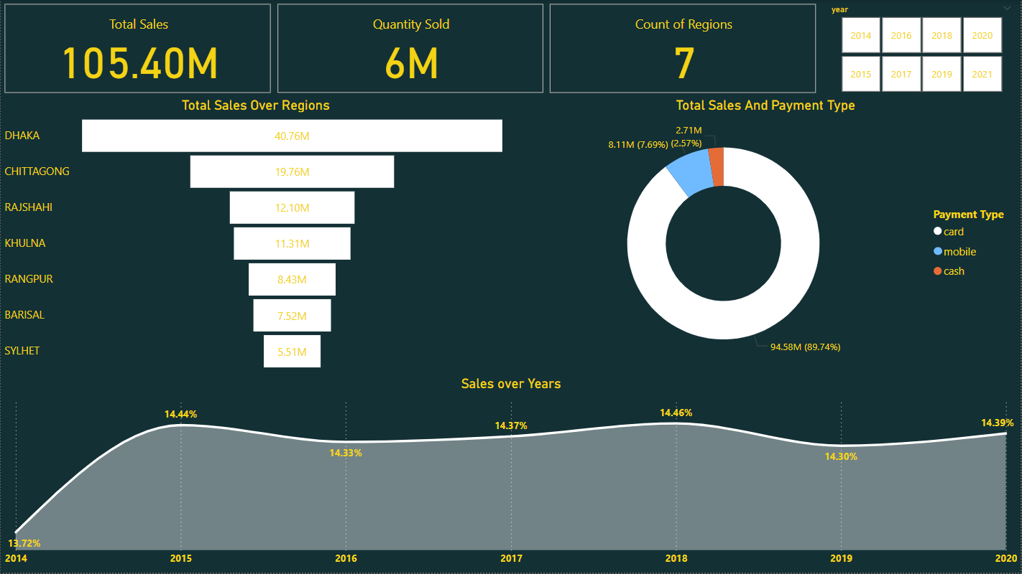

Slide 18
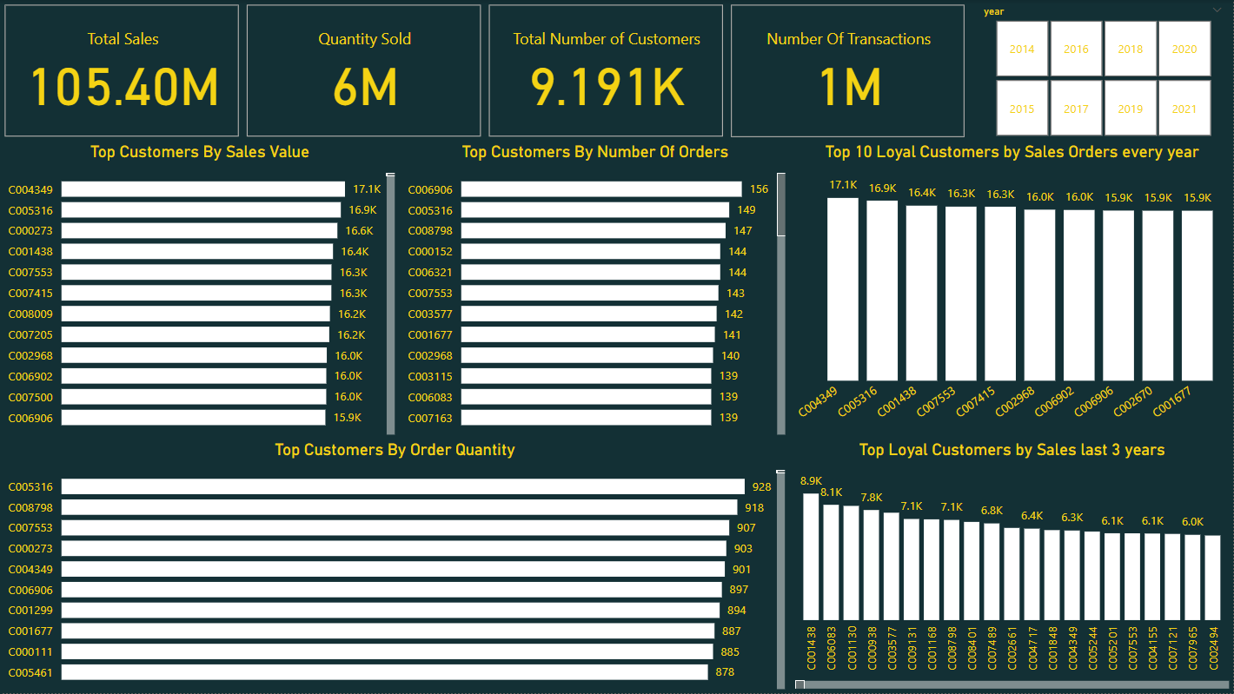

Slide 19
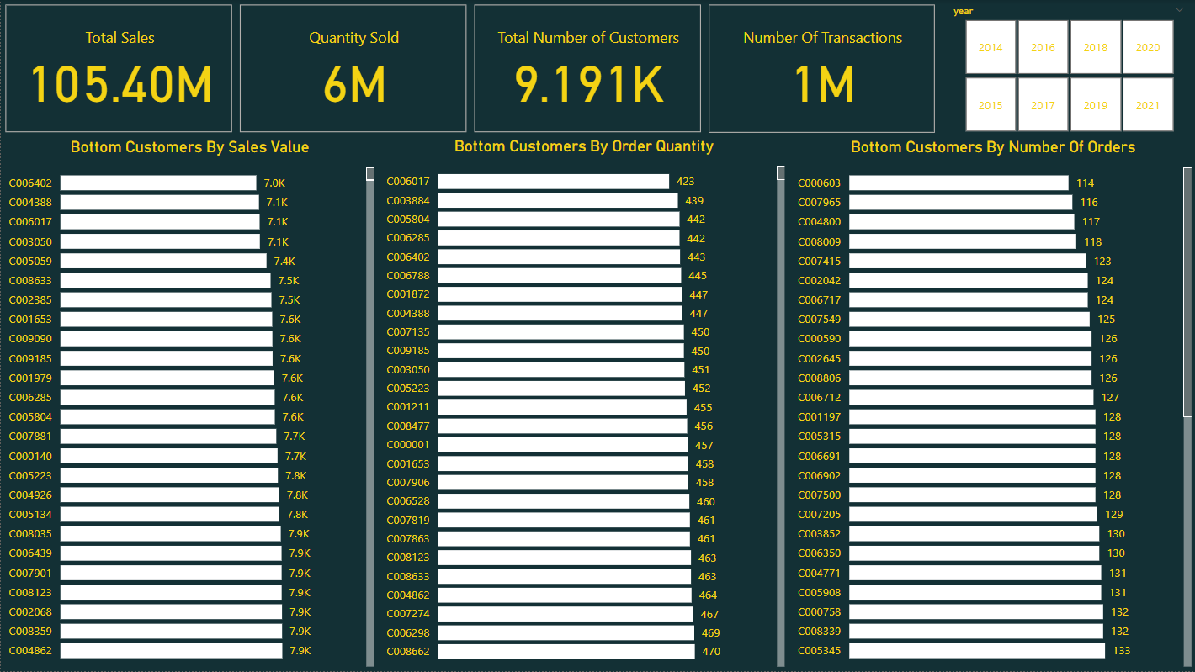

Slide 20
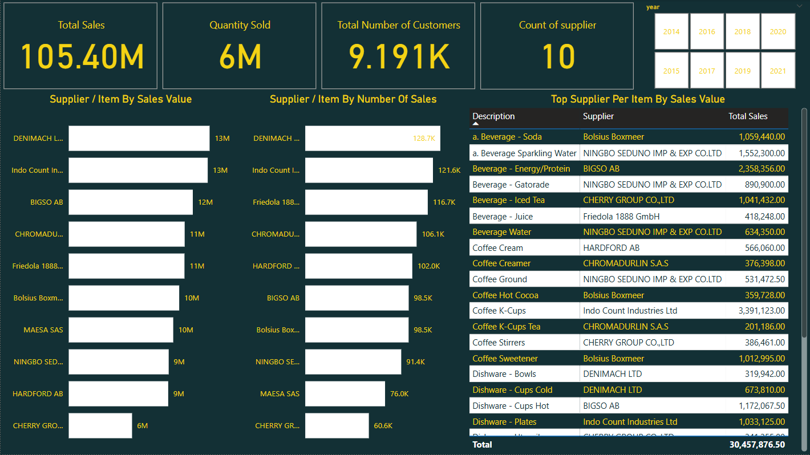

Slide 21
WE WANT TO SAY
THANK YOU
FOR YOUR ATTENTION

